Slide 1
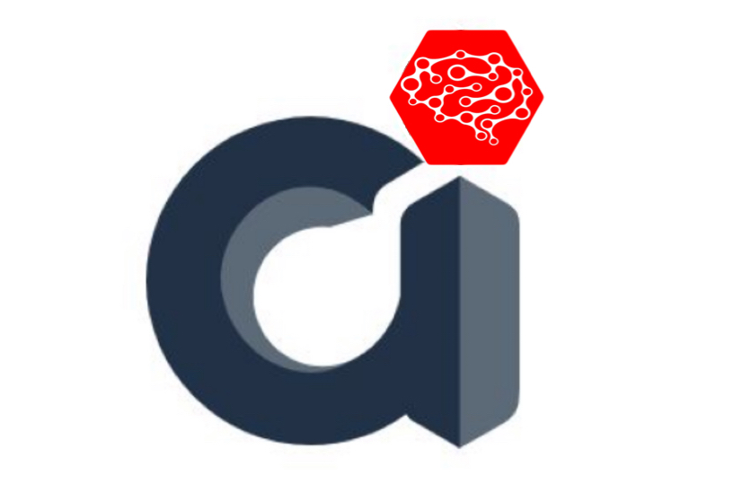
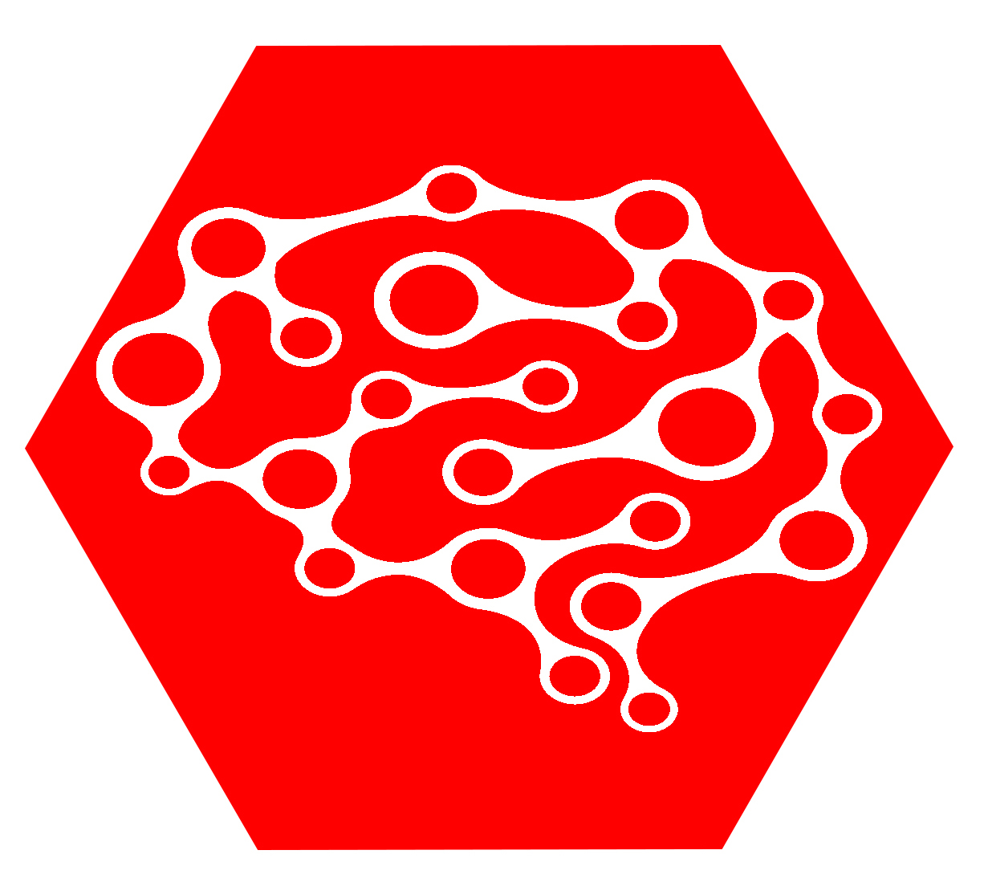

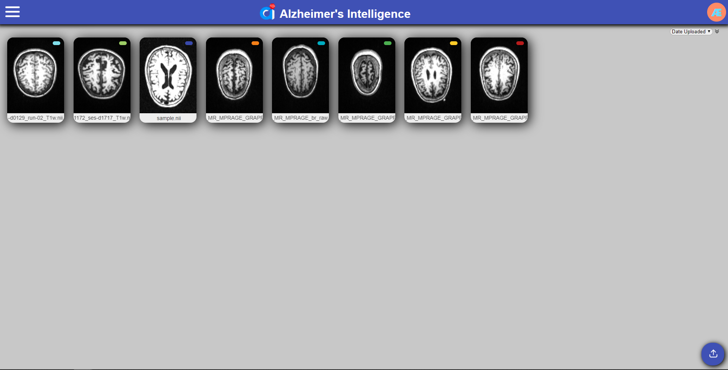
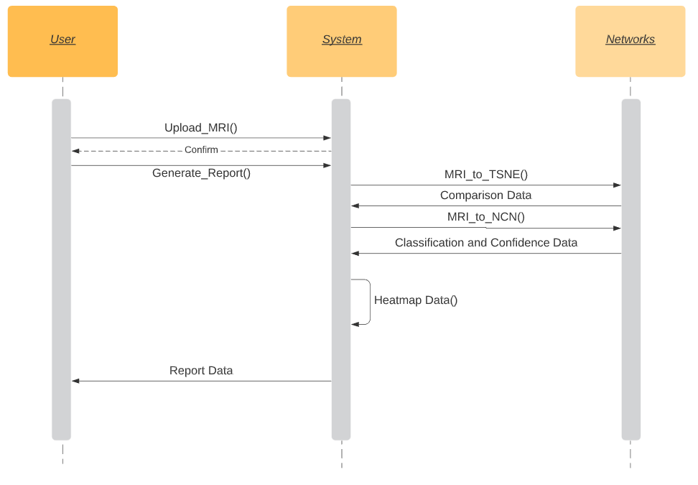
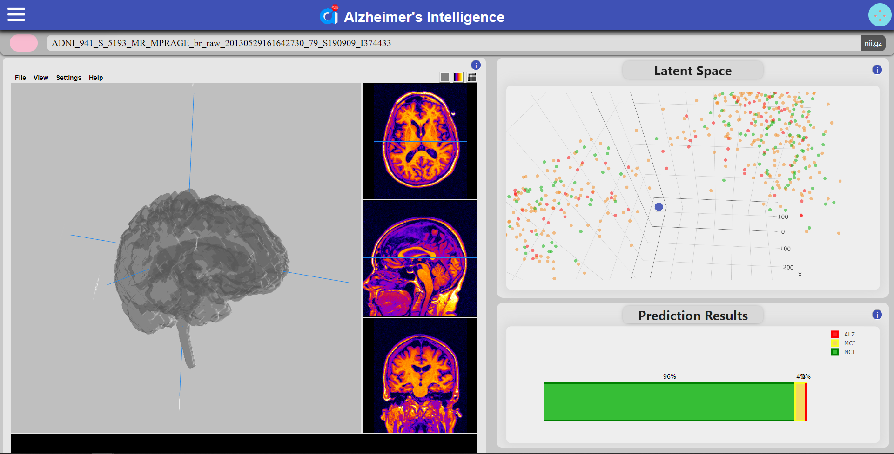




Alzheimer’s Intelligence
Compact Mind
Erik Ostlind, jeo170030@utdallas.edu; Cem Bozkus, cbb170003@utdallas.edu; Ryan Hosford, rph160030@utdallas.edu; Andrew Hosang, ajh150830@utdallas.edu; Jules Francois, jtf150430@utdallas.edu
CS 4485 / Spring 2020
Department of Computer Science
Erik Jonsson School of Engineering & Computer Science
The University of Texas at Dallas
Richardson, TX 75080, USA
Abstract
Results
We aim to scan MRI images to analyze Alzheimer’s patients to aid in diagnosis with an emphasis on early diagnosis. Using data analysis and visualization on a dataset of Alzheimer’s patient MRI images, we aim to generate reports for patients and doctors in a user-friendly environment. The overall project incorporates UI design, high-performance infrastructure constraints and artificial intelligence data analysis in an end to end product.
Backend
Python
Flask
Tensorflow
Frontend
React
Papaya
Plotly
Architecture
Impact
Summary:
This project is designed to be a diagnosis aid for doctors and patients fighting against the Alzheimer's disease. With this project we aim to improve early diagnosis options as well as make it easier for the general public to have access to much needed checkups by designing the project in the e-care space.
This system provides doctors and patients a way to analyze their MRI scans to spot any cognitive impairments in a user-friendly and easy to digest way. This can be used alongside conventional diagnosis techniques to provide a second opinion to doctors.
Performance
Using our system, a patient is able to upload a MRI scan and receive a report showing the likelihood that they have any cognitive impairments within seconds. The user can also store and manage multiple MRI scans for comparison.
Used client side caching to improve website responsiveness and reduce web server calls. We employed a Nvidia Tesla K80, a state of the art computation accelerator, to improve inference and mesh generation times.

